Slide 1

VAAGDEVI ENGINEERING COLLEGE DEPARTMENT OF COMPUTER SCIENCE ENGINEERING A MAJOR PROJECT PRESENTATION Smart Attendance System Using Face Recognition Under the guidance of : V.Madhavi(Asst.Professor)
submitted by:
M.Kavya-18UK1A05N5
T.Arun-17UK1AA05N3
R.Sreeja Reddy-18UK1A05N2
P.Shanthan Reddy-17UK1A0524

Slide 2
CONTENTS
Introduction
Analysis
Requirements
Data flow diagram
Project Flow
Out Put
Deployment
Conclusion
Future enhancement

Slide 3
INTRODUCTION
Maintaining the attendance is very important in all the organization for checking the performance of an Employee or Students.
Every organization has its own method in this regard. Some are marking attendance manually using the old paper or file based approach.
Some have adopted methods of automatic attendance using some biometric techniques.
But in these methods employees have to wait for long time in making a queue at time they enter the office.

Slide 4
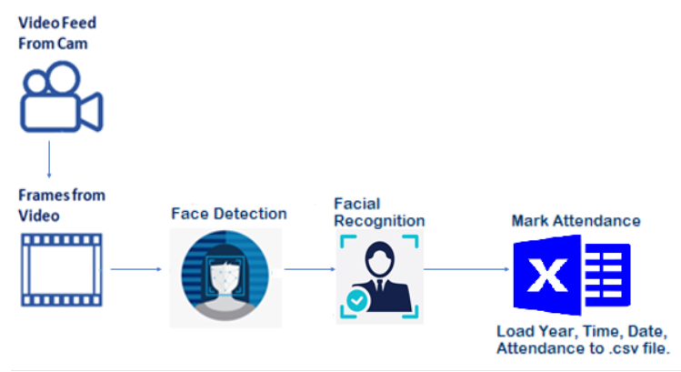
ANALYSIS
Use of face recognition for the purpose of attendance marking is the smart way of attendance management system.
Face recognition involves two steps,
first step involves the detection of faces and second step consist of identification of those detected face images with the existing database.

Slide 5
REQUIREMENTS
Software Requirements
Spyder IDE
Python(pandas, numpy ,keras ,tensorflow)
Visual studio community 2019
Libraries to be Installed.
1. Opencv .
command => pip install python-opencv
2. Dlib
command => pip install dlib
3.face_recognition
command =>pip install face_recognition
4.Cmake

Slide 6
To build a smart attendance system you must require the following packages Install dlib dlib is an open-source library used for face detection. We recommend installing dlib updated version for better compatibility with OpenCV. Given a face, dlib which is a pre-trained model can extract features from the face like eyes, nose, lips, and jaw using facial landmarks. For installation of dlib refer to the below link(in anaconda prompt) https://tinyurl.com/Requiredinstallations Install face-recognition Built using dlib's state-of-the-art face recognition built with deep learning. The model has an accuracy of 99.38% on the Labeled Faces in the Wild benchmark.This also provides a simple face_recognition command line tool that lets you do face recognition on a folder of images from the command line For installation of face-recognition refer to the below link(in anaconda prompt) https://pypi.org/project/face-recognition/ Install OpenCV OpenCV is a library of programming functions mainly aimed at real-time computer vision. Here, OpenCV is used to capture frames by accessing the webcam in real-time. Open anaconda prompt and type command “pip install opencv-python”

Slide 7
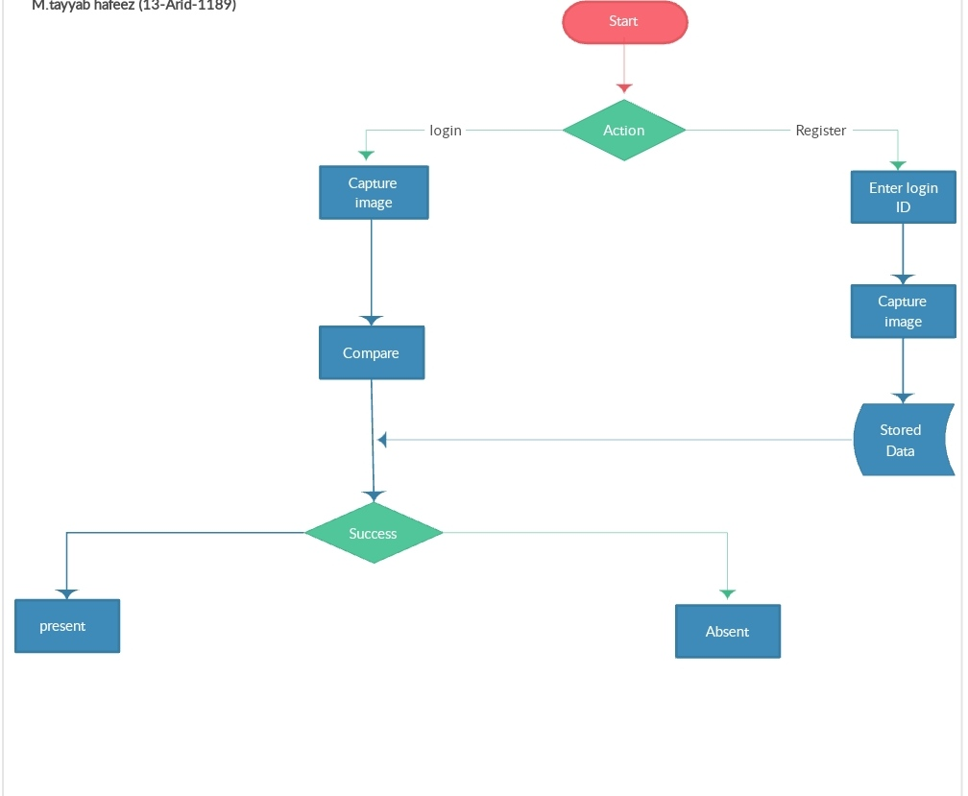
Data flow diagram

Slide 8
Project Flow
We can divide the process of developing smart attendance system into the following steps:
1.Open the integrated webcam when the user clicks mark attendance button.
2. Detecting the face in the video stream.
3. Recognising the face in the video stream.
4. Displaying bounding boxes around the detected face with the name.
5. Mark the attendance along with name and time in a log file(excel file).
To accomplish this, we have to complete all the activities and tasks listed below
Create dataset
Face detection using dlib
Import Necessary Libraries
Face Encoding
Video Capture
Capturing the input frames
Face Recognition
Convert the image from BGR to RGB
Encoding the input image
Compare input image with known faces
Mark Attendance
Load the data to CSV file
Displaying the result
Application Building
Build an HTML Page
Build the python flask app
Run the application

Slide 9
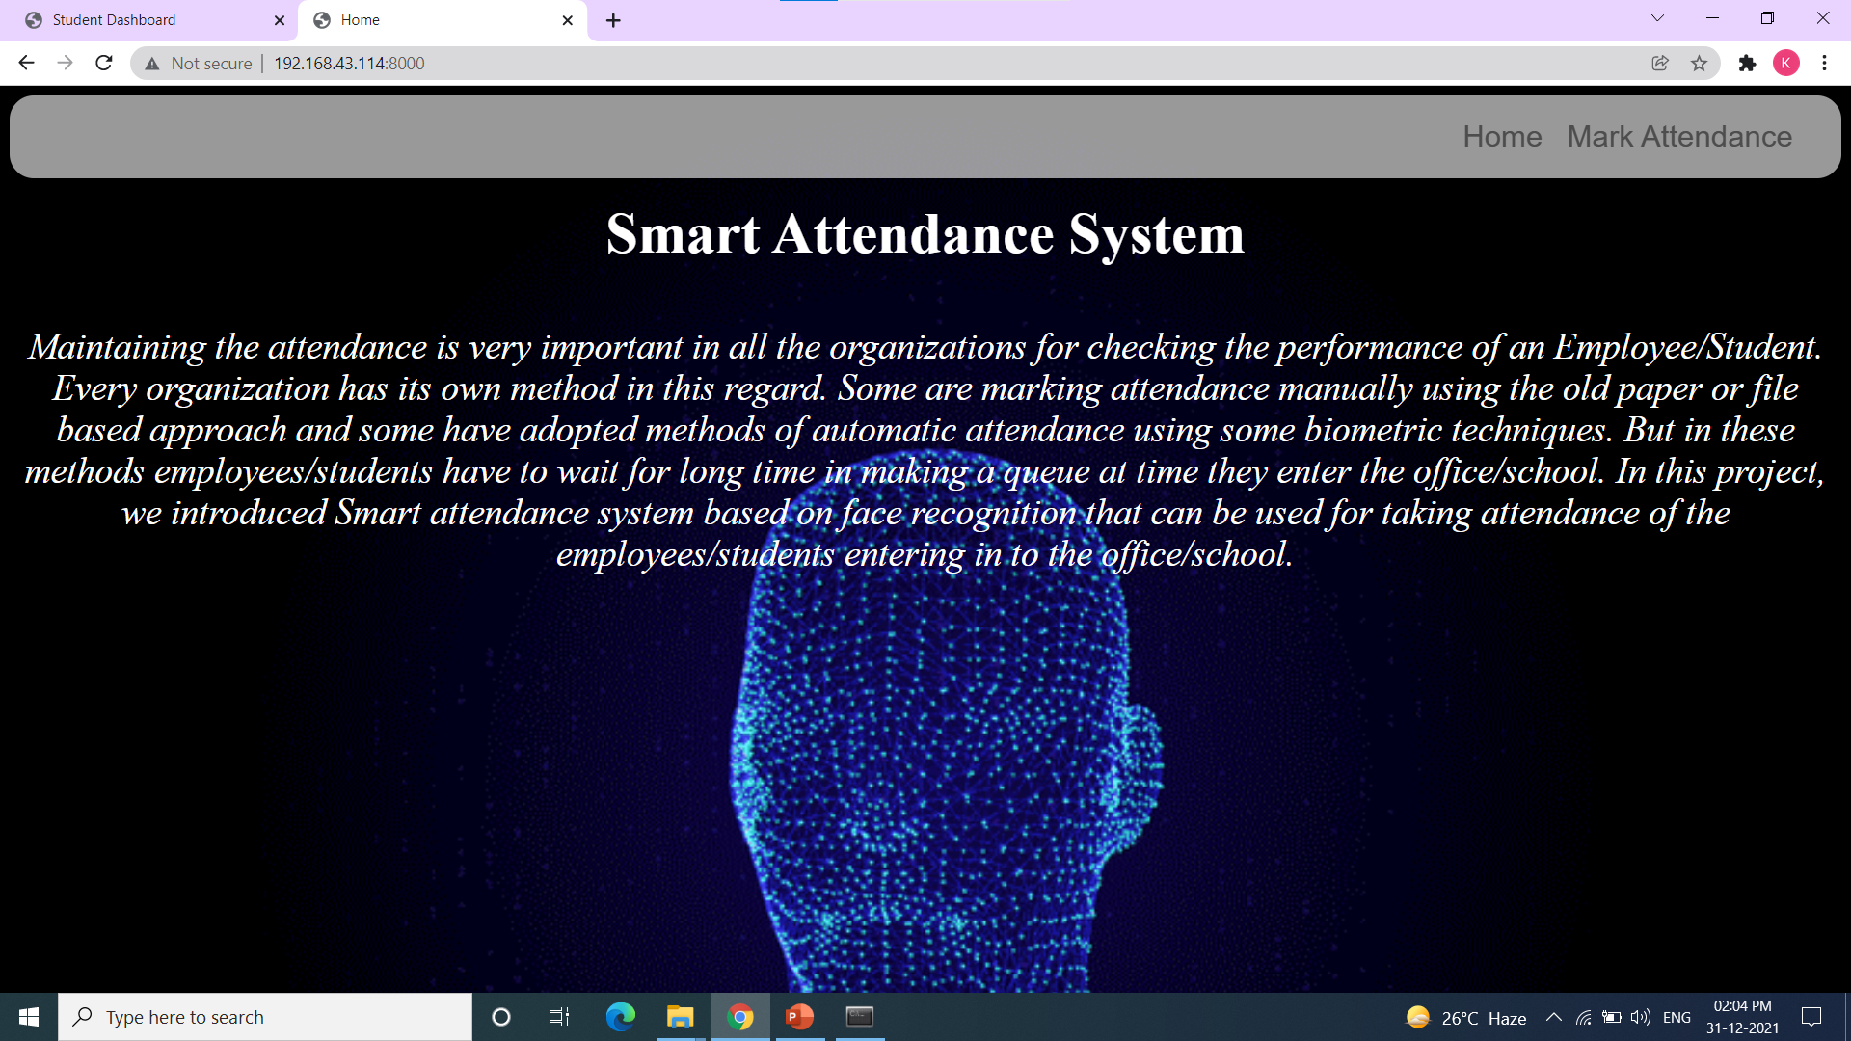
Out put: Home Page

Slide 10
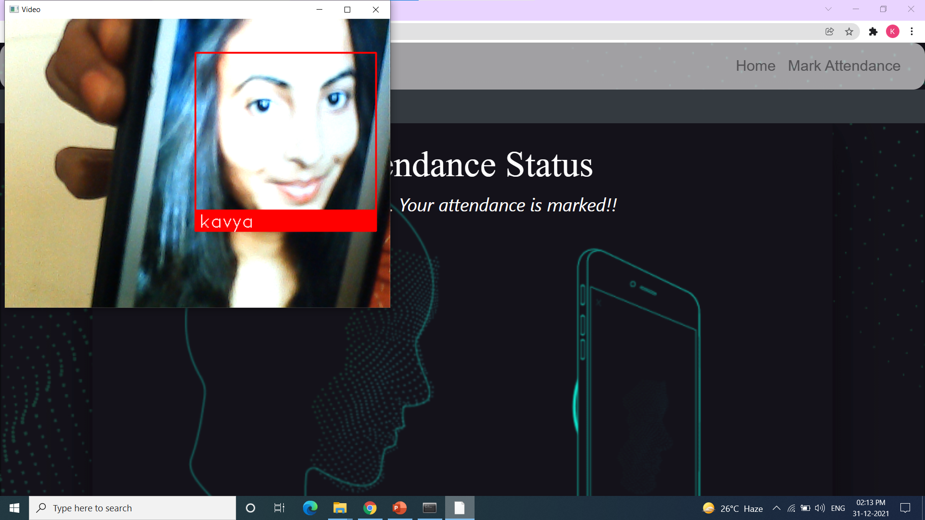
Face Recognition

Slide 11
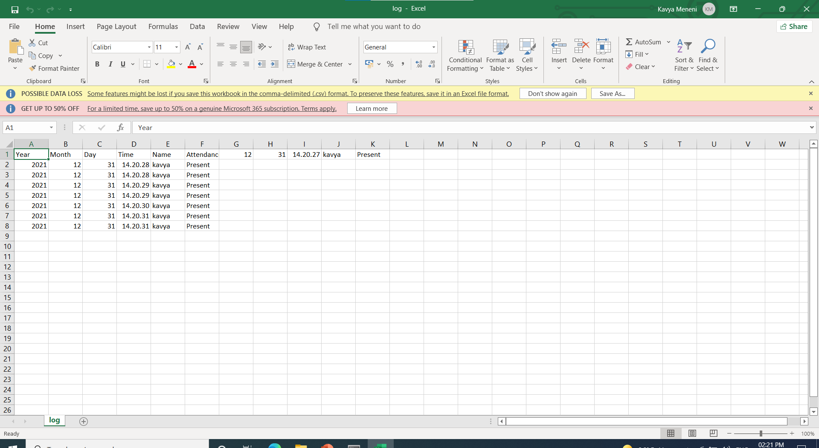
DATA BASE log.csv

Slide 12
DEPLOYMENT
The interface for the Smart Attendance System has been created. Using the interface the images of the individual students is being recorded and stored in the training dataset.
Simultaneously their information is stored in the database i.e. excel sheet. Finally the images of the students is being tracked and recognized

Slide 13
CONCLUSION
Smart attendance management system is designed to solve the issues of existing manual systems.
Hence maintaining attendance automatically with the help of face recognition will be very helpful and less prone to errors as compared to manual process.
This will also reduce manipulation of attendance record done by students and it will save time as well.
We have used face recognition concept to mark the attendance of student and make the system better.
The system performs satisfactory in different poses and variations.

Slide 14
FUTURE ENHANCEMENT
In future this system need be improved because these system sometimes fails to recognize students from some distance, also we have some processing limitation, working with a system of high processing may result even better performance of this system.

Slide 15
THANK YOU

